Slide 1
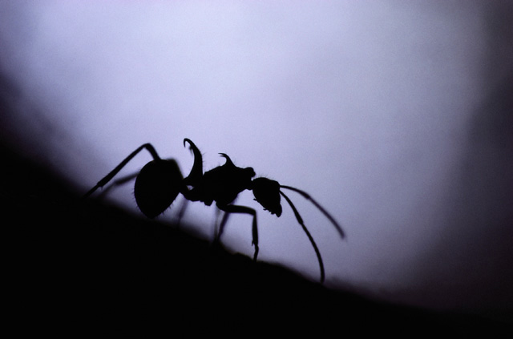
Ant Colony Optimization
Real ants
Stigmergy
Autocatalyzation
Ant System
Ant Colony System

Slide 2
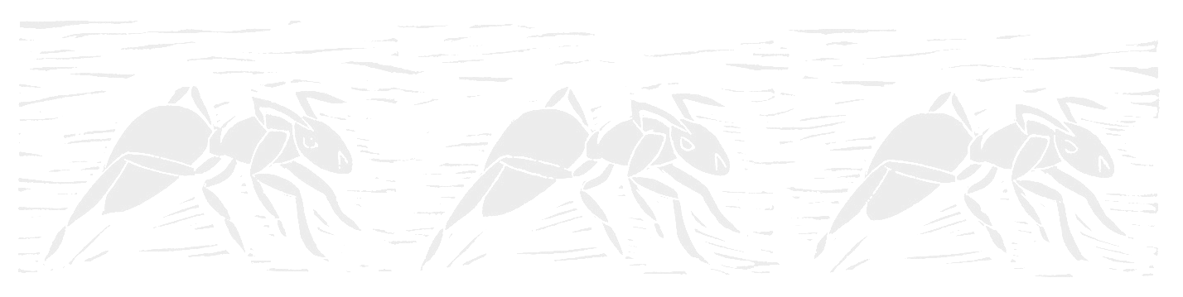

Overview
“Ant Colony Optimization (ACO) studies artificial systems that take inspiration from the behavior of real ant colonies and which are used to solve discrete optimization problems.”
-Source: ACO website, http://iridia.ulb.ac.be/~mdorigo/ACO/about.html
Ant Colony Optimization (ACO)
Notes:
Was first introduced in Marco Dorigo’s Ph.D. thesis.
As we have seen, the TSP provides an excellent test environment…
In problems like the quadratic assignment problem and the sequential ordering problem these ACO algorithms outperform all known algorithms on vast classes of benchmark problems.

Slide 3
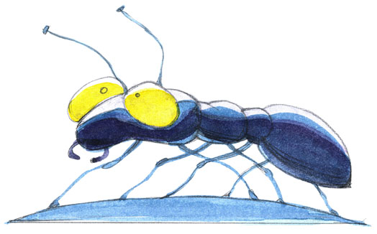
Almost blind.
Incapable of achieving complex tasks alone.
Rely on the phenomena of swarm intelligence for survival.
Capable of establishing shortest-route paths from their colony to feeding sources and back.
Use stigmergic communication via pheromone trails.
Notes:
Ethologist discovered pheromones

Slide 4
Follow existing pheromone trails with high probability.
What emerges is a form of autocatalytic behavior: the more ants follow a trail, the more attractive that trail becomes for being followed.
The process is thus characterized by a positive feedback loop, where the probability of a discrete path choice increases with the number of times the same path was chosen before.
Notes:
Ethologist discovered pheromones

Slide 5

Naturally Observed Ant Behavior
All is well in the world of the ant.
Ant Colony Optimization (ACO)
Notes:
Was first introduced in Marco Dorigo’s Ph.D. thesis.
As we have seen, the TSP provides an excellent test environment…
In problems like the quadratic assignment problem and the sequential ordering problem these ACO algorithms outperform all known algorithms on vast classes of benchmark problems.

Slide 6
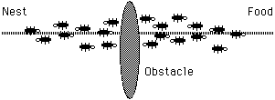
Naturally Observed Ant Behavior
Oh no! An obstacle has blocked our path!
Ant Colony Optimization (ACO)
Notes:
Was first introduced in Marco Dorigo’s Ph.D. thesis.
As we have seen, the TSP provides an excellent test environment…
In problems like the quadratic assignment problem and the sequential ordering problem these ACO algorithms outperform all known algorithms on vast classes of benchmark problems.

Slide 7
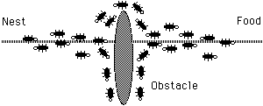
Naturally Observed Ant Behavior
Where do we go? Everybody, flip a coin.
Ant Colony Optimization (ACO)
Notes:
Was first introduced in Marco Dorigo’s Ph.D. thesis.
As we have seen, the TSP provides an excellent test environment…
In problems like the quadratic assignment problem and the sequential ordering problem these ACO algorithms outperform all known algorithms on vast classes of benchmark problems.

Slide 8
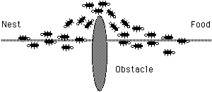
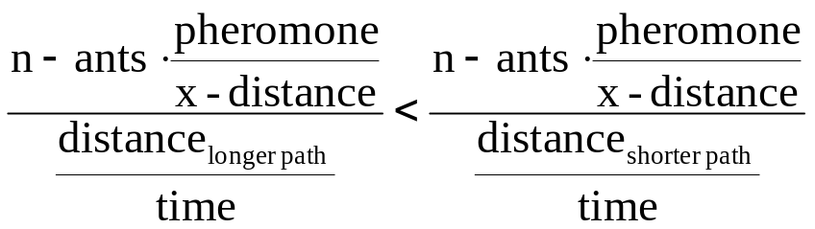
Naturally Observed Ant Behavior
Shorter path reinforced.
Ant Colony Optimization (ACO)
Notes:
Was first introduced in Marco Dorigo’s Ph.D. thesis.
As we have seen, the TSP provides an excellent test environment…
In problems like the quadratic assignment problem and the sequential ordering problem these ACO algorithms outperform all known algorithms on vast classes of benchmark problems.

Slide 9
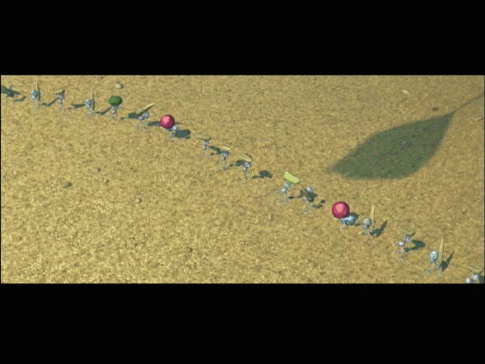

Slide 10
“Stigmergic?”
Stigmergy, a term coined by French biologist Pierre-Paul Grasse, is interaction through the environment.
Two individuals interact indirectly when one of them modifies the environment and the other responds to the new environment at a later time. This is stigmergy.
Ant Colony Optimization (ACO)

Slide 11
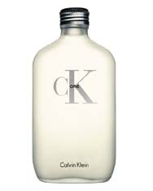
Stigmergy
Real ants use stigmergy. How again?
PHEROMONES!!!
Ant Colony Optimization (ACO)

Slide 12
Autocatalyzation
What is autocatalytic behavior?
Ant Colony Optimization (ACO)

Slide 13
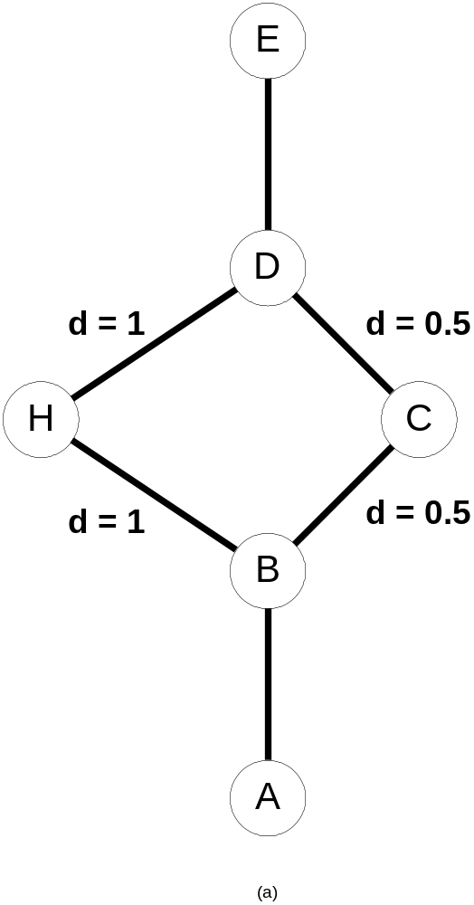
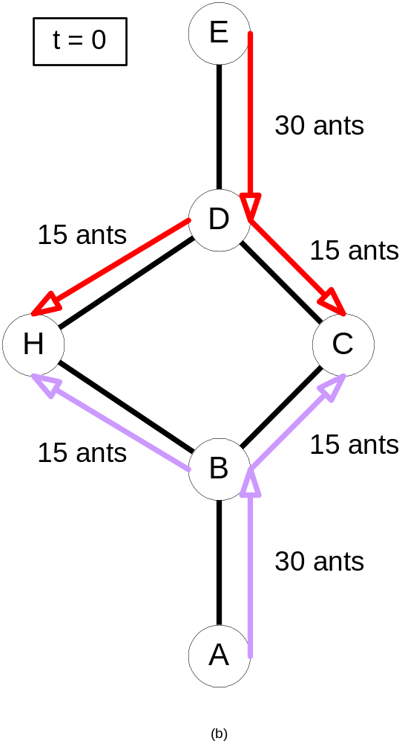
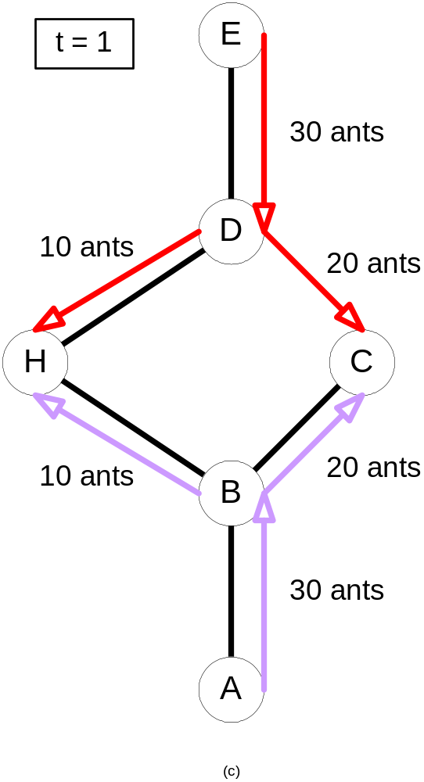
Initial state:
no ants
τ = 15
τ = 30
τ = 15
τ = 30

Slide 14
Autocatalyzation
This is why ACO algorithms are called autocatalytic positive feedback algorithms!
Remember that!
Ant Colony Optimization (ACO)

Slide 15
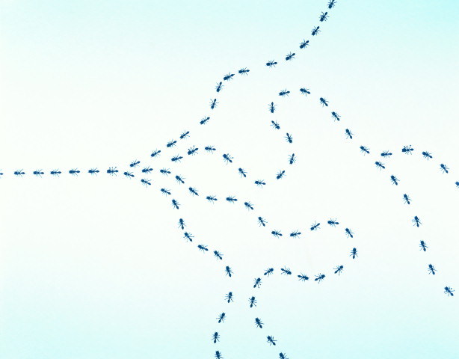
Ant Colony Optimization
The Ant System (AS)
Notes:
Represented a new computational paradigm.
Proposed as a viable new approach to stochastic combinatorial optimization.
Main characteristics of this model are positive feedback, distributed computation, and the use of a constructive greedy heuristic.

Slide 16
Ant System
First introduced by Marco Dorigo in 1992
Progenitor to “Ant Colony System,” later discussed
Result of research on computational intelligence approaches to combinatorial optimization
Originally applied to Traveling Salesman Problem
Applied later to various hard optimization problems
Ant Colony Optimization (ACO)
Notes:
Was first introduced in Marco Dorigo’s Ph.D. thesis.
As we have seen, the TSP provides an excellent test environment…
In problems like the quadratic assignment problem and the sequential ordering problem these ACO algorithms outperform all known algorithms on vast classes of benchmark problems.

Slide 17
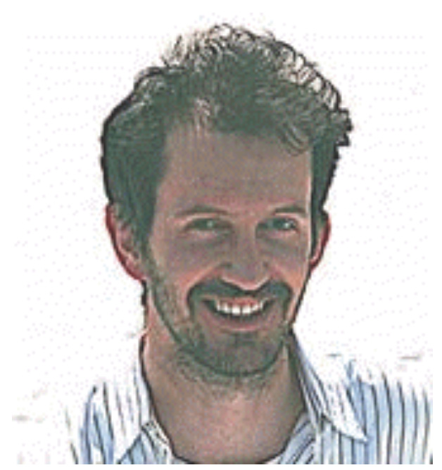
Would you trust this man?
Ant Colony Optimization (ACO)
Notes:
Was first introduced in Marco Dorigo’s Ph.D. thesis.
As we have seen, the TSP provides an excellent test environment…
In problems like the quadratic assignment problem and the sequential ordering problem these ACO algorithms outperform all known algorithms on vast classes of benchmark problems.

Slide 18
Performance Chart
Problem Name | MST | AS | ACS_{R&D} | ACS_{D} | GA | EP | SA | Optimum
Eil50 (50-city problem) | 615 [1] 44.71% | 450 [36] 5.89% | 463.423 [3] 9.04% | 425 [1,830] 0.00% | 428 [25,000] 0.71% | 426 [100,000] 0.23% | 443 [68.512] 4.24% | 425 [N/A]
Eil75 (75-city problem) | 740 [1] 38.31% | 570 [238] 6.5% | 576.749 [10] 7.80% | 545 [3,840] 1.87% | 545 [80,000] 1.87% | 542 [325,000] 1.31% | 580 [173,250] 8.41% | 535 [N/A]
KroA100 (100-city problem) | 30517 [1] 43.39% | 22,943 [228] 7.81% | 24497.6 [37] 15.11% | 21,282 [4,820] 0.00% | 21,761 [103,000] 2.25% | N/A [N/A] N/A | N/A [N/A] N/A | 21,282 [N/A]
Our Results
MST 2-approximation TSP algorithm
AS Ant System
(α = 1, β = 5, ρ = .5)
ACS_{R&D} Ant Colony System
(α = 0.1, β =2, ρ = .1, m = 50)
Published Results
ACS_{D} Ant Colony System
GA Genetic Algorithm
EP Evolutionary Programming
SA Simulated Annealing
Ant Colony System
Notes:
Was first introduced in Marco Dorigo’s Ph.D. thesis.
As we have seen, the TSP provides an excellent test environment…
In problems like the quadratic assignment problem and the sequential ordering problem these ACO algorithms outperform all known algorithms on vast classes of benchmark problems.

Slide 19
Ants as Agents
Each ant is a simple agent with the following characteristics:
It chooses the town to go to with a probability that is a function of the town distance and of the amount of trail present on the connecting edge;
To force the ant to make legal tours, transitions to already visited towns are disallowed until a tour is complete (this is controlled by a tabu list);
When it completes a tour, it lays a substance called trail on each edge (i, j) visited.
Ant Colony Optimization (ACO)
Notes:
Was first introduced in Marco Dorigo’s Ph.D. thesis.
As we have seen, the TSP provides an excellent test environment…
In problems like the quadratic assignment problem and the sequential ordering problem these ACO algorithms outperform all known algorithms on vast classes of benchmark problems.

Slide 20
The symmetric TSP has a Euclidean based problem space. We use d_{ij} to denote the distance between any two cities in the problem. As such
d_{ij} = [(x_{i}-x_{j})² + (y_{i}-y_{j})²]^{1/2}
Ant Colony Optimization (ACO)
Notes:
Was first introduced in Marco Dorigo’s Ph.D. thesis.
As we have seen, the TSP provides an excellent test environment…
In problems like the quadratic assignment problem and the sequential ordering problem these ACO algorithms outperform all known algorithms on vast classes of benchmark problems.

Slide 21
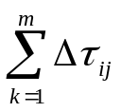
We let τ_{ij}(t) denote the intensity of trail on edge (i,j) at time t. Trail intensity is updated following the completion of each algorithm cycle, at which time every ant will have completed a tour. Each ant subsequently deposits trail of quantity Q/L_{k} on every edge (i,j) visited in its individual tour. Notice how this method would favor shorter tour segments. The sum of all newly deposited trail is denoted by ∆ τ_{ij}. Following trail deposition by all ants, the trail value is updated using τ_{ij}(t + n) = р × τ_{ij}(t) + ∆ τ_{ij}, where p is the rate of trail decay per time interval and ∆ τ_{ij = .}
Ant Colony Optimization (ACO)
Notes:
Was first introduced in Marco Dorigo’s Ph.D. thesis.
As we have seen, the TSP provides an excellent test environment…
In problems like the quadratic assignment problem and the sequential ordering problem these ACO algorithms outperform all known algorithms on vast classes of benchmark problems.

Slide 22
Two factors drive the probabilistic model:
1) Visibility, denoted η_{ij}, equals the quantity 1/d_{ij}
2) Trail, denoted τ_{ij}(t)
These two factors play an essential role in the central probabilistic transition function of the Ant System.
In return, the weight of either factor in the transition function is controlled by the variables α and β, respectively. Significant study has been undertaken by researchers to derive optimal α:β combinations.
Ant Colony Optimization (ACO)
Notes:
Was first introduced in Marco Dorigo’s Ph.D. thesis.
As we have seen, the TSP provides an excellent test environment…
In problems like the quadratic assignment problem and the sequential ordering problem these ACO algorithms outperform all known algorithms on vast classes of benchmark problems.

Slide 23
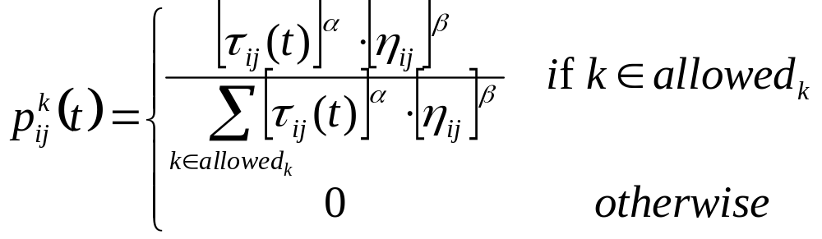
Probabilistic Transition Function
Ant Colony Optimization (ACO)
Notes:
Was first introduced in Marco Dorigo’s Ph.D. thesis.
As we have seen, the TSP provides an excellent test environment…
In problems like the quadratic assignment problem and the sequential ordering problem these ACO algorithms outperform all known algorithms on vast classes of benchmark problems.

Slide 24
A high value for α means that trail is very important and therefore ants tend to choose edges chosen by other ants in the past. On the other hand, low values of α make the algorithm very similar to a stochastic multigreedy algorithm.
Ant Colony Optimization (ACO)
Notes:
Was first introduced in Marco Dorigo’s Ph.D. thesis.
As we have seen, the TSP provides an excellent test environment…
In problems like the quadratic assignment problem and the sequential ordering problem these ACO algorithms outperform all known algorithms on vast classes of benchmark problems.

Slide 25
Ant System (AS) Algorithm
Initialization
Randomly place ants
Build tours
Deposit trail
Update trail
Loop or exit
Ant Colony Optimization (ACO)
Notes:
Was first introduced in Marco Dorigo’s Ph.D. thesis.
As we have seen, the TSP provides an excellent test environment…
In problems like the quadratic assignment problem and the sequential ordering problem these ACO algorithms outperform all known algorithms on vast classes of benchmark problems.

Slide 26
Computational Complexity
The complexity of this ACO algorithm is O(NC×n² ×m) if we stop the algorithm after NC cycles, where n is the number of cities and m is the number of ants.
Step 1 is O(n² + m)
Step 2 is O(m)
Step 3 is O(n² × m)
Step 4 is O(n² × m)
Step 5 is O(n²)
Step 6 is O(n × m)
Researchers have found a linear relation between the number of towns and the best number of ants, so the complexity of the algorithm is O(NC ×n³).
Ant Colony Optimization (ACO)
Notes:
Was first introduced in Marco Dorigo’s Ph.D. thesis.
As we have seen, the TSP provides an excellent test environment…
In problems like the quadratic assignment problem and the sequential ordering problem these ACO algorithms outperform all known algorithms on vast classes of benchmark problems.

Slide 27
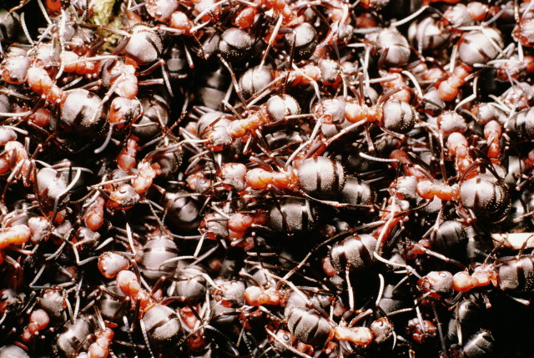
How many ants do you need?
m ≈ n

Slide 28
Ant Colony Optimization
The Ant Colony System (ACS)
Notes:
Represented a new computational paradigm.
Proposed as a viable new approach to stochastic combinatorial optimization.
Main characteristics of this model are positive feedback, distributed computation, and the use of a constructive greedy heuristic.

Slide 29
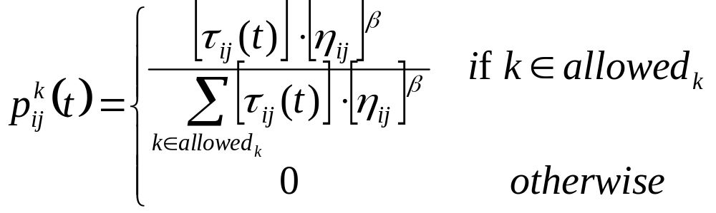
AS  ACS
Change to the probabilistic function: drop alpha
Ant Colony Optimization (ACO)
Notes:
Was first introduced in Marco Dorigo’s Ph.D. thesis.
As we have seen, the TSP provides an excellent test environment…
In problems like the quadratic assignment problem and the sequential ordering problem these ACO algorithms outperform all known algorithms on vast classes of benchmark problems.

Slide 30
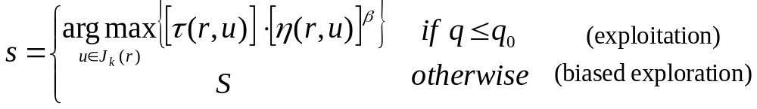
AS  ACS
New state transition rule; used to balance between exploration and exploitation.
Here q₀ is a constant parameter, q is a random variable, and S is the outcome of the probabilistic transition function.
Ant Colony Optimization (ACO)
Notes:
Was first introduced in Marco Dorigo’s Ph.D. thesis.
As we have seen, the TSP provides an excellent test environment…
In problems like the quadratic assignment problem and the sequential ordering problem these ACO algorithms outperform all known algorithms on vast classes of benchmark problems.

Slide 31
AS  ACS
Local updating rule:
Here ∆tau₀ is a predetermined constant or function. The edge (r,s) is updated following each iteration of an ant search.
Ant Colony Optimization (ACO)
Notes:
Was first introduced in Marco Dorigo’s Ph.D. thesis.
As we have seen, the TSP provides an excellent test environment…
In problems like the quadratic assignment problem and the sequential ordering problem these ACO algorithms outperform all known algorithms on vast classes of benchmark problems.

Slide 32
How many ants do you need?
m = 10

Slide 33
Advanced Topics
Discrete Approaches to
ACO Improvement
& Implementation

Slide 34
Check out
http://www.conquerware.com/
dbabb/academics/research/aco
for supplementary materials.
Ant Colony Optimization (ACO)
Notes:
Was first introduced in Marco Dorigo’s Ph.D. thesis.
As we have seen, the TSP provides an excellent test environment…
In problems like the quadratic assignment problem and the sequential ordering problem these ACO algorithms outperform all known algorithms on vast classes of benchmark problems.

Slide 35
Conclusion
The main characteristics of this class of algorithms are a natural metaphor, a stochastic nature, adaptivity, inherent parallelism, and positive feedback. Ants have evolved a highly efficient method of solving the difficult Traveling Salesman Problem. Furthermore, the Ant Colony Optimization can be applied to many other hard problems.
Ant Colony Optimization (ACO)
Notes:
Was first introduced in Marco Dorigo’s Ph.D. thesis.
As we have seen, the TSP provides an excellent test environment…
In problems like the quadratic assignment problem and the sequential ordering problem these ACO algorithms outperform all known algorithms on vast classes of benchmark problems.

Slide 36
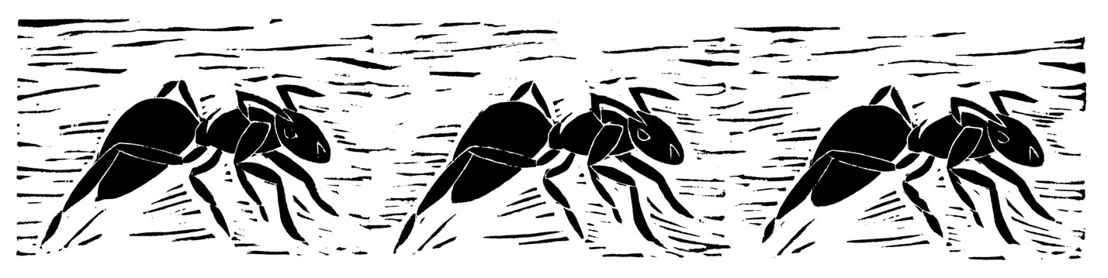
Questions, Comments?
Thank You

